Slide 1

SCIENCE TECHNOLOGY SOCIETY
HM 216
AUTUMN 2022

Slide 2
SCIENCE, TECHNOLOGY, SOCIETY
UNIT I Introduction: STS as a Field of Study
UNIT II History of Science in South Asia: Colonial roots
UNIT III (Focus): Engendering Science & Technology
UNIT IV Group Projects + Presentations (to run concurrently with Unit III)

Slide 3
evaluation
Group Project: 50
Final Exam: 40
Presentation: 10
[Bonus points for participation (Instructors’ + TA’s discretion): 5]

Slide 4
SCIENCE, TECHNOLOGY, SOCIETY
… is a growing field of study around the world that seeks to understand how science and technology shape human lives and livelihoods, and how society and culture, in turn, shape the development of science and technology.
STS seeks to provide insights into the deep relationship between science and technology and such basic categories of social thought as race, gender, class, the environment, democracy and development, and human rights, by focusing attention on science and technology as social institutions.
Introduction to some of the key philosophical, sociological and historical approaches towards understanding the workings of science and technology in our times.

Slide 5
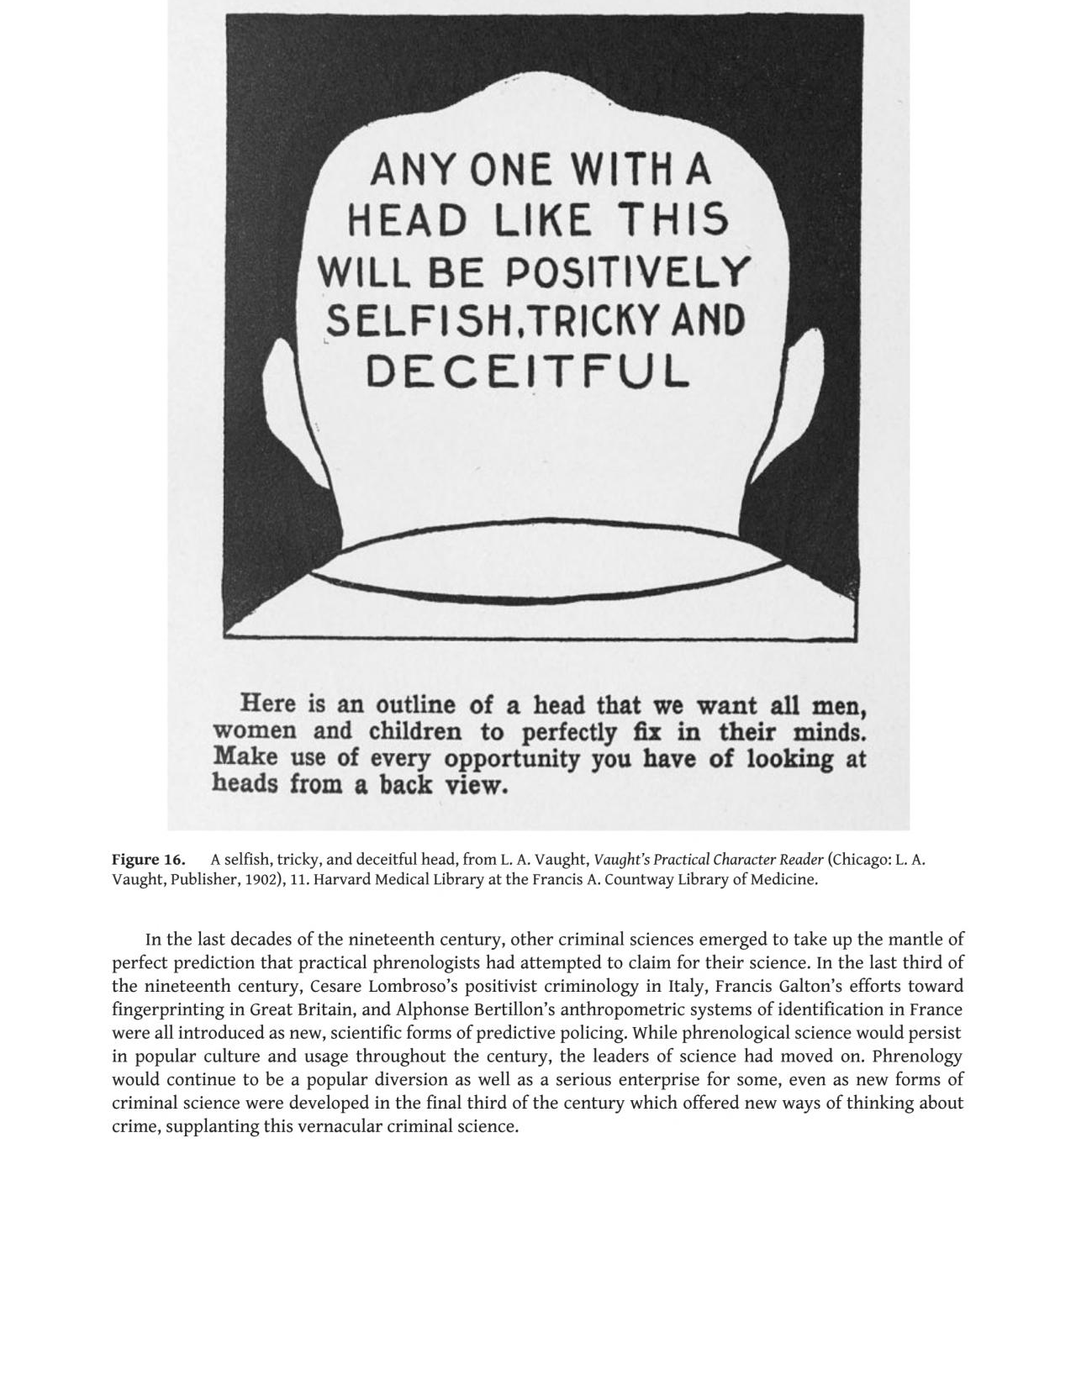
Science and Race
The image is from a 1902 book published in the US, titled Vaught’s Practical Character Reader (by L.A Vaught)
An Organ of Murder: Crime, Violence, and Phrenology in Nineteenth-Century America by a historian of science, Courtney E. Thompson
Notes:
Link: https://books.google.co.in/books?id=R00IEAAAQBAJ&pg=PT98&lpg=PT98&dq=Phrenological+Knowledge+and+the+Social+Structure+of+Early+Nineteenth-Century+Edinburgh.%E2%80%9D&source=bl&ots=WWUkYWnwRc&sig=ACfU3U21P0T6tf7FYsv_N-127yJhyTGc0w&hl=en&sa=X&ved=2ahUKEwiMztXplKX5AhXJdHAKHZThDhsQ6AF6BAgbEAM#v=onepage&q=Phrenological%20Knowledge%20and%20the%20Social%20Structure%20of%20Early%20Nineteenth-Century%20Edinburgh.%E2%80%9D&f=false

